Slide 1
Zoom
Training 2022-1

Slide 2
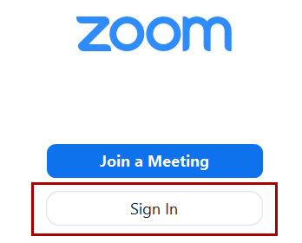
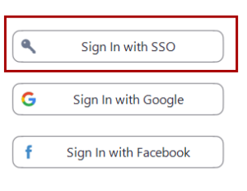
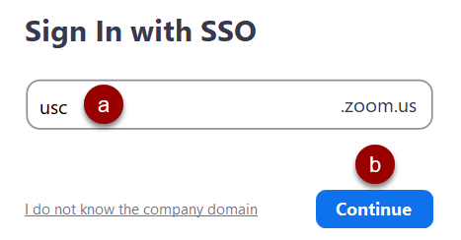
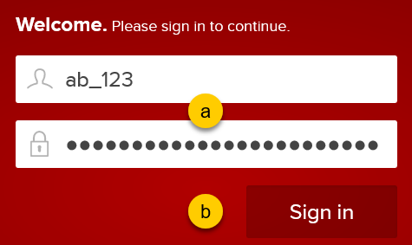
ZOOM Training 2022-1
Always use SSO
Unified Communications and Collaboration, Infrastructure Services

Slide 3
ZOOM Training 2022-1
Always use SSO
Unified Communications and Collaboration, Infrastructure Services

Slide 4
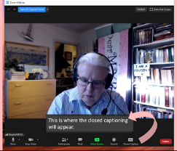
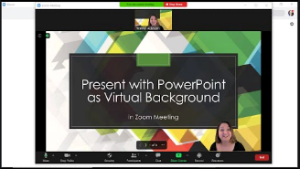
Zoom new and Enhanced features
Self-set breakout rooms
New Security Features
Calendly for scheduling
The host can now create breakout rooms with the option for participants to self-select which breakout room they would like to join.
There is now an option in the Zoom Security panel to immediately suspend all participant activities,
Choosing Zoom as your event location will automatically create video conference details and save them to your Calendly event.
Alt. Host
Closed captioning live transcription
Slides as virtual backgrounds
Alternative hosts: Shares the same controls as co-hosts, but can also start the meeting. Hosts can assign alternative hosts when they schedule a meeting.
This service will transcribe spoken voice to text live during the meeting. This service is expected to better support meeting participants who have special accommodations.
This allows you to share your presentation as a virtual background and allows your participants to view your video imposed directly on the screen share.
Unified Communications and Collaboration, Infrastructure Services

Slide 5
ZOOM Training 2022-1
Self-set breakout rooms
New Security Features
Calendly For Scheduling
Calendly is a great tool for 1 on 1 meetings such as office hours and appointments
Choosing Zoom as your event location will automatically create video conference details and save them to your Calendly event.
Providing your invitees instant access to these details will save you time and help reduce meeting no-shows.
Once an event is scheduled, the Zoom details will be automatically included in the confirmation notifications and a calendar event will be sent to your invitees.
Enhanced co-host privileges over Breakout Rooms
Co-hosts have the same breakout room controls as the meeting host, such as starting or ending breakout rooms, assigning participants, etc.
Move participants to main session from breakout room Hosts and co-hosts have the option to assign a participant back to the main session, rather than ending all breakout sessions.
Host and Participants must be on version 5.4.6
New option in the Security panel to immediately suspend all participant activities, which will mute all video and audio, stop screen sharing, end all breakout rooms, and pause recording.
Remove Participant Allows the removal of a participant from a meeting. The participant can not re-join
Lock Meeting: Locks the meeting, keeping new participants from joining the meeting.
Allow or disallow: Share Screen, Chat, Rename Themselves, Unmute themselves. Start Video, or Annotate on Shared Content
Unified Communications and Collaboration, Infrastructure Services

Slide 6
ZOOM Training 2022-1
Alternate Hosts
Closed Captioning for Live Transcriptions
Slides as virtual backgrounds
Alternative hosts: Shares the same controls as co-hosts, but can also start the meeting. Hosts can assign alternative hosts when they schedule a meeting.
When scheduling a meeting, the host can designate another Licensed user on the same account to be the alternative host.
The alternative host can start the meeting on the host's behalf.
This user will receive an email notifying them that they've been added as an alternative host, with a link to start the meeting.
Zoom has provided USC with an opportunity to participate in the early release of live closed captioning for Zoom meetings.
This service will transcribe spoken voice to text live during the meeting and will assist in better supporting students and other meeting participants who need special accommodations.
Live captioning is made possible through artificial intelligence; we expect the transcription accuracy to be consistent with services such as rev.com or otter.ai.
Note that this is not ADA Compliant
While you can share PowerPoint presentations or share Keynote presentations in meetings, you can also share your presentation as a Virtual Background for an immersive sharing experience.
Sharing your slides as a Virtual Background allows your participants to view your video imposed directly on the screen share.
It also allows you to manage your presentation directly from within the Zoom meeting controls.
Note: Sound, transitions, or animations embedded in slides are not supported.
Unified Communications and Collaboration, Infrastructure Services

Slide 7
ZOOM Training 2022-1
Annotation Vanishing Pen
Immersive View
How and why to check for updates
New annotation tool: Vanishing Pen
Windows, macOS, Linux In addition to the arrow and spotlight tools, Vanishing Pen will allow the presenter to mark on the shared screen to highlight certain information, but the markings will fade away within a couple of seconds.
This provides easier highlighting of information without having to undo or erase annotations.
Recreate the feel of your class or conference room by placing up to 25 video participants onto a single virtual background.
Participants are automatically placed onto provided scenes and the host can adjust the arrangements as needed. The host can also use their own custom background for a unique scene.
While this does not require use of the Virtual Background feature, it does work best when everyone has this functionality.
Zoom regularly provides new versions of the Zoom desktop client and mobile app to release new features and fix bugs. We recommend upgrading to the latest version once it is available.
You can also check which version you're currently running.
Follow Zoom release notes to stay updated on the latest Zoom releases.
Unified Communications and Collaboration, Infrastructure Services

Slide 8
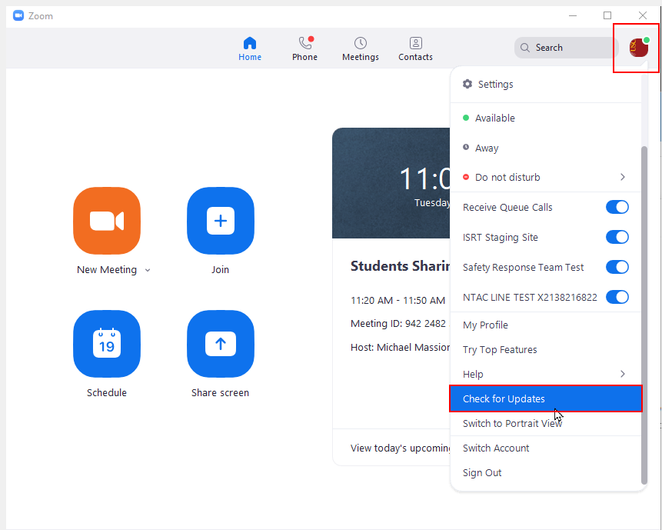
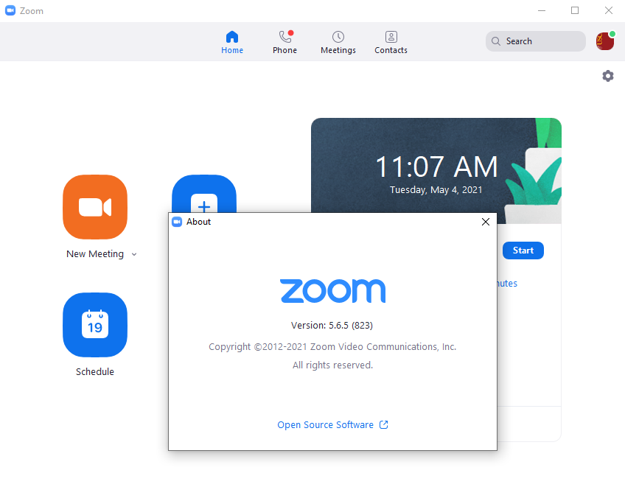
ZOOM Training 2022-1
How to check for updates
In your Zoom application: Check for updates or Look at Help and about zoom to check your version
Unified Communications and Collaboration, Infrastructure Services

Slide 9
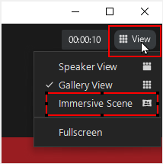
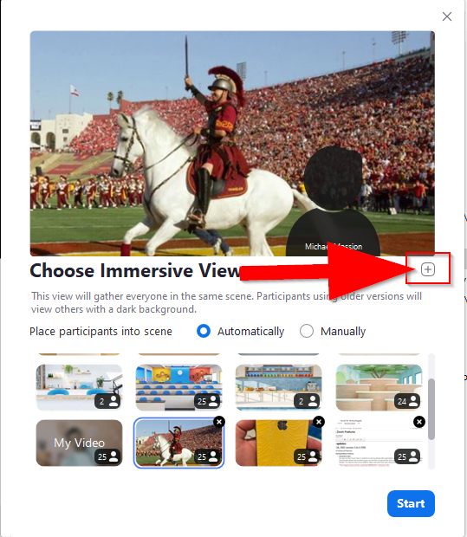
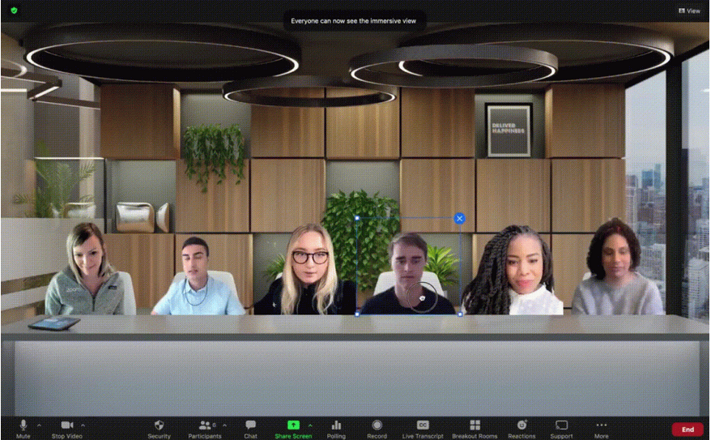
ZOOM Training 2022-1
Immersive View
Start a Meeting then select View in the upper right corner
Unified Communications and Collaboration, Infrastructure Services

Slide 10
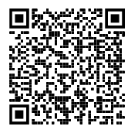
ZOOM Training 2022-1
TIPS and LINKS
Users with Scheduling Privilege on your account will be able to manage and act as an alternative host for all meetings.
Recurring meetings with No Fixed Time. This is a great way to have recurring meetings with the same meeting ID with out using PMI.
Review Blackboard Zoom Link and Blackboard Zoom overview.
Raise hand is now in reactions.
Useful links:
https://keepteaching.usc.edu
https://keepteaching.usc.edu/zoom-updates/
https://keepteaching.usc.edu/zoommeetingnotes/
https://keepteaching.usc.edu/wp-content/uploads/2020/09/QRC-Set-Up-and-Facilitate-in-Zoom-Zoom-Lecturer-v4.0.pdf
USC ITS SUPPORT Email : Consult@usc.edu Tel: (213) 740-5555
Unified Communications and Collaboration, Infrastructure Services

Slide 11
ZOOM Training 2022-1
Useful links:
https://zoom.us/support/download
https://blog.zoom.us/introducing-zoom-immersive-view/
https://support.zoom.us/hc/en-us/sections/360008531132
Zoom Releases By Date
https://support.zoom.us/hc/en-us/sections/201214205-Release-Notes
Release Notes
https://keepteaching.usc.edu/faculty/quick-start-toolkit/zoom-rooms/zoom-rooms-hybrid/
Pre-Assign Zoom Breakout Rooms
USC ITS SUPPORT Email : Consult@usc.edu Tel: (213) 740-5555
Unified Communications and Collaboration, Infrastructure Services

