Slide 1
Slack: Training

Slide 2
01
Objectives
02
Slack Overview
03
Getting Started
Presentation
Agenda
04
Use Cases
05
Install Channel Tools
06
Slack on Keep Teaching
07
Q&A

Slide 3
training objectives
Upon completion of this presentation, you should be able to:
Understand your role and Describe the advantages of using slack at usc.
1
2
explain and show how to set up and use slack.
3
find additional resources on the keep teaching website.
Our Office in New Jersey

Slide 4
Slack overview
Slack is a central collaboration hub for students, faculty and staff that creates a unified experience by connecting the Trojan community.
Slack:
Enables sharing of documents, files and assignments and pinning important information to channels.
Enhances interaction with students by using it for Q&A via threaded conversations, real-time discussions or conducting polls related to content discussed in class.
Works seamlessly with Zoom, Google Drive, and other common educational tools.
Provides a way to search that supports real-time messaging, content sharing, learning, work and more.
Notes:
Note to Presenter: “Why do you use Slack in the Classroom” video is embedded in the black box.
See “What is Slack?” and “Slack for the Classroom” sections of Slack Resources on Keep Teaching Website

Slide 5
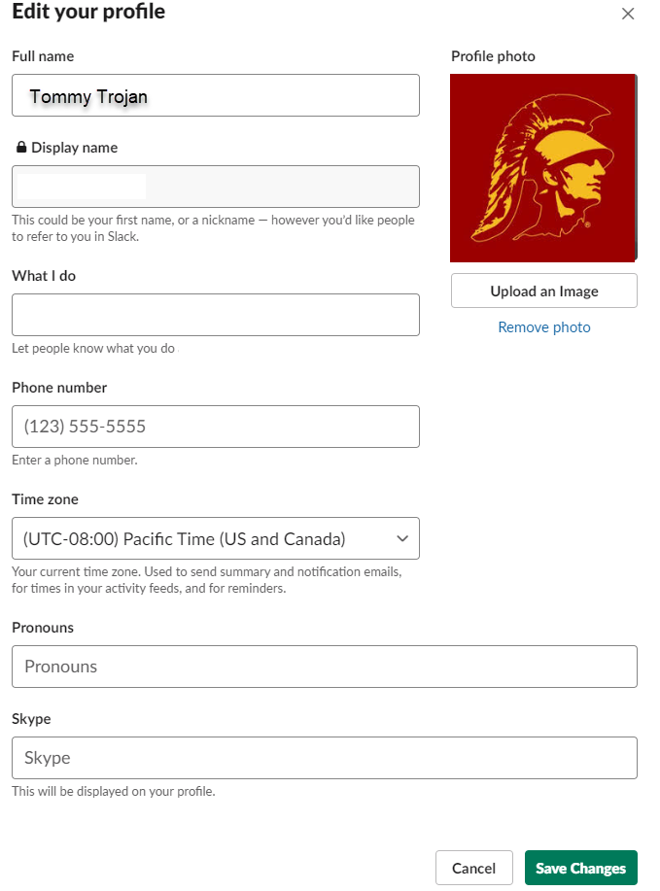
Getting started: setting up your profile
your profile:
Having an accurate profile will help you work more effectively with other students, staff, and faculty across the university.
Your profile lets people know who you are, what you do, and how you can be contacted.
Add a profile picture for additional personalization.
Note: You cannot update your full name or display name.

Slide 6
GETTING STARTED: Managing the “Noise”
Update notifications in Preferences
Determine how you want to be notified when you receive: Messages, Mentions, Keywords, Thread replies
Pause notifications for a certain period of time
Do Not Disturb
Leave channels you don’t need/use
Unfollow threads
Set yourself reminders
Star key channels

Slide 7
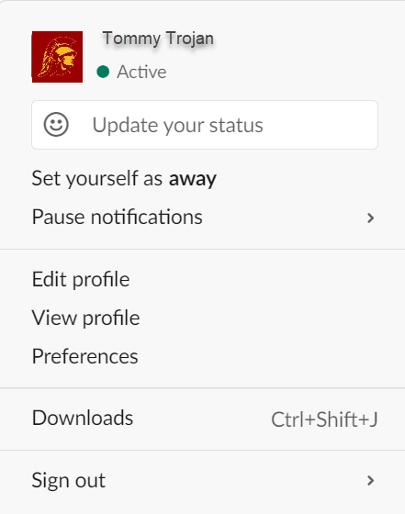
Getting started: Status & Notifications
Status:
It is helpful to let your class and peers know how quickly you can respond to messages and when you're available.
You can manually set yourself to active or away at any time.
Notifications keep you informed about things that need your attention.
The default desktop notifications are automatically enabled as soon as you join a workspace.
You can adjust your notification settings to get alerts when you want them.
Notifications:

Slide 8
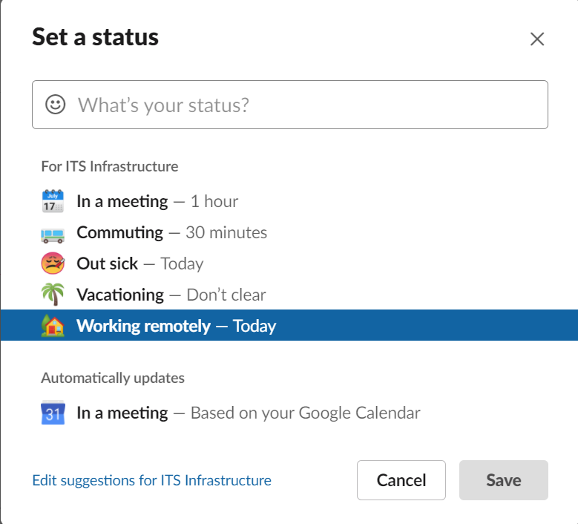
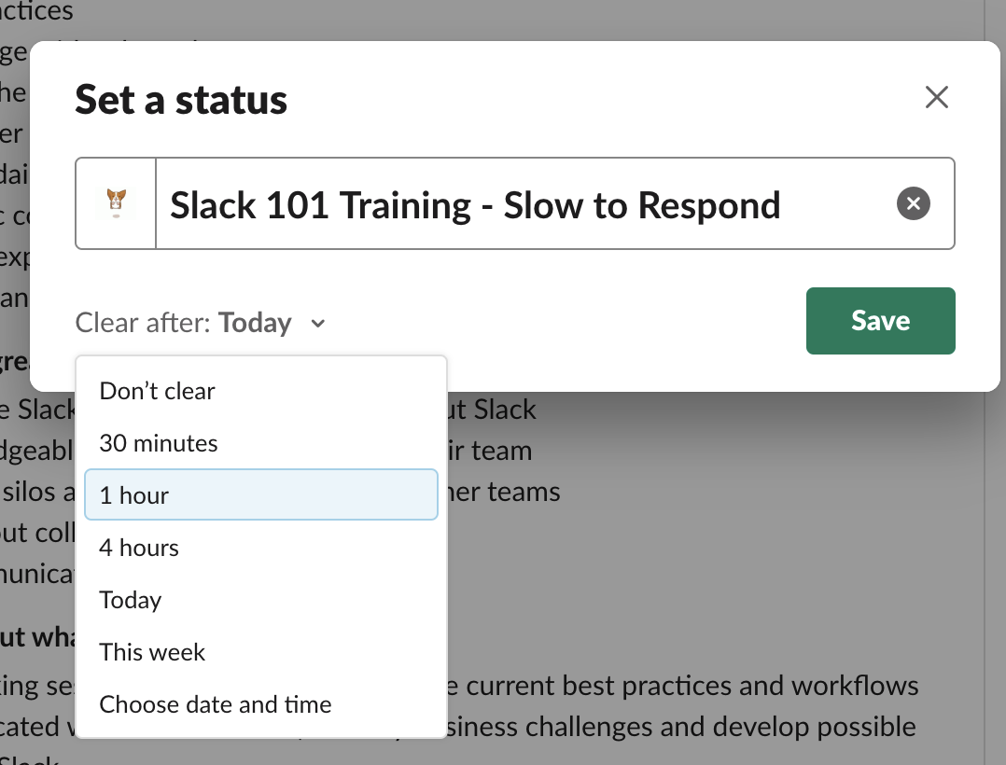
Getting Started: Protect your time with custom Statuses

Slide 9
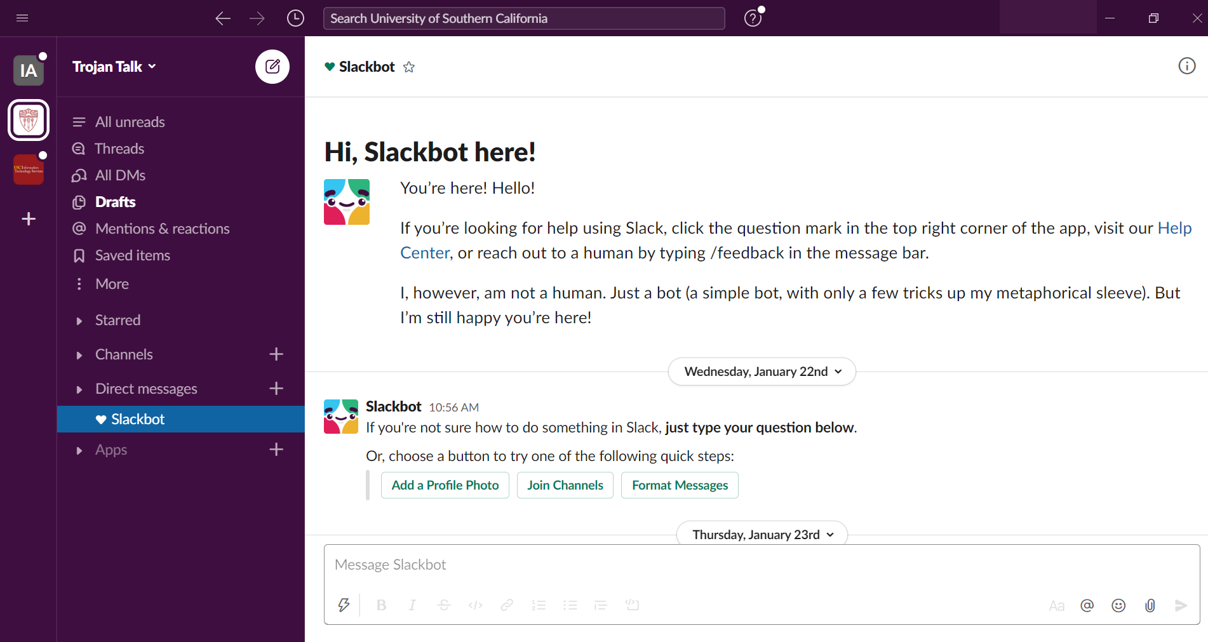
getting Started: Interface
Workspaces
Separate instances of Slack at USC. A workspace has its own administrators and permission settings, and its own members, channels and apps to enable a large group of people to collaborate long-term.
Channels
Context-based conversations where groups of people can communicate and interact with information related to a common topic (e.g., project, committee, etc.). These can be public or private and can be within a workspace or shared across multiple channels.
Channel Name
Provides first-glance insight into what conversation is contained in the channel. This should follow a shared convention for consistency across campus.

Slide 10
Getting Started: communication & Apps
Direct messages
Direct messages (DM) are 1:1 conversations with teammates or conversations of up to 8 people on more one-off topics. These “DMs” are visible to users across the USC grid.
Chat box
Once you are in a channel or DM, you can type text into the message box and send it to the channel or DM to communicate. You can also use the paper clip icon to upload files or add attachments.
Search
Enter search words here to search all the information that has been shared publicly at USC. Including message, files, channels or people.
Apps
Add apps to your workspace to connect the tools and services you use every day and get more work done without leaving Slack.

Slide 11
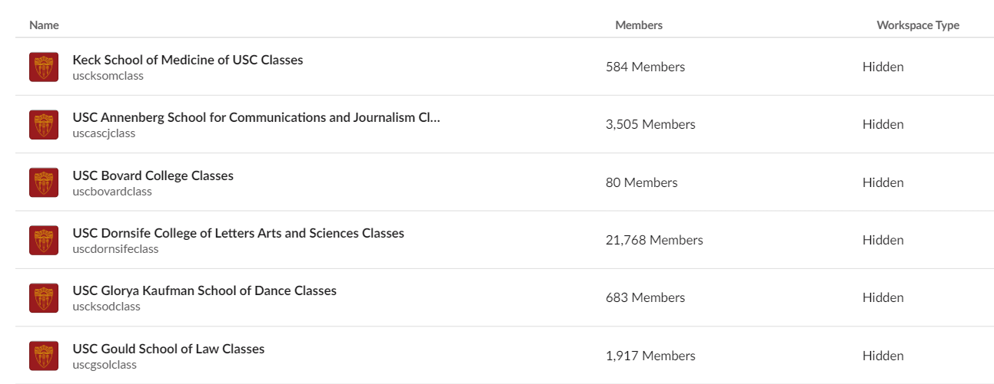
SLACK: USC Grid workspaces
School workspaces ending in –classes
Business workspaces
Other workspaces categories

Slide 12
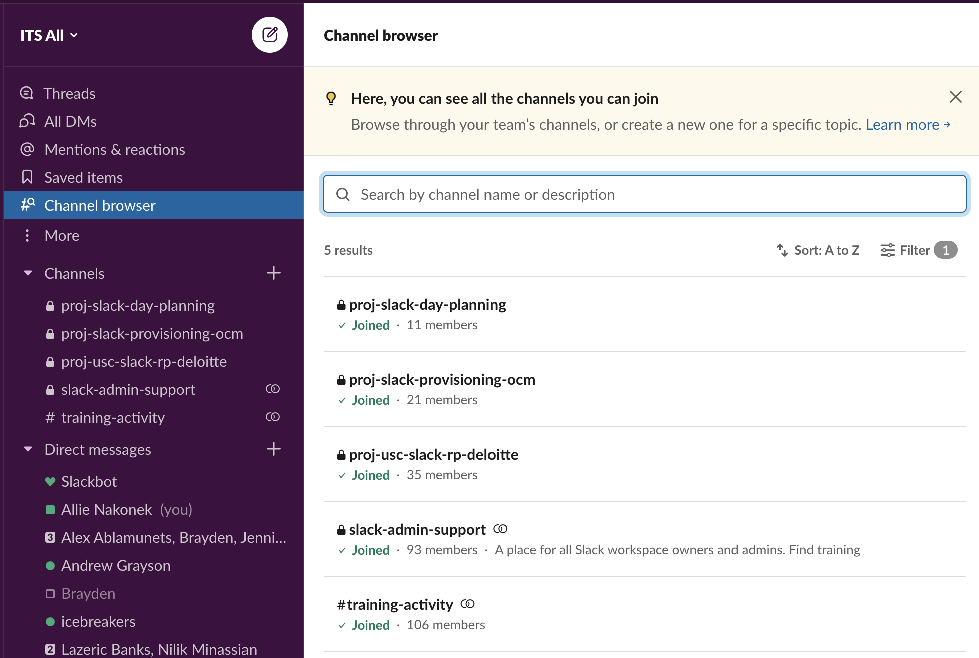
SLACK: Finding Channel(s) within your workspace
One cardinal rule in Slack is search first. Use the Channel Browser to find out what channels already exist and see which you may already be a member of in your sidebar.
Don’t see one that is relevant to your team? Time to create!

Slide 13
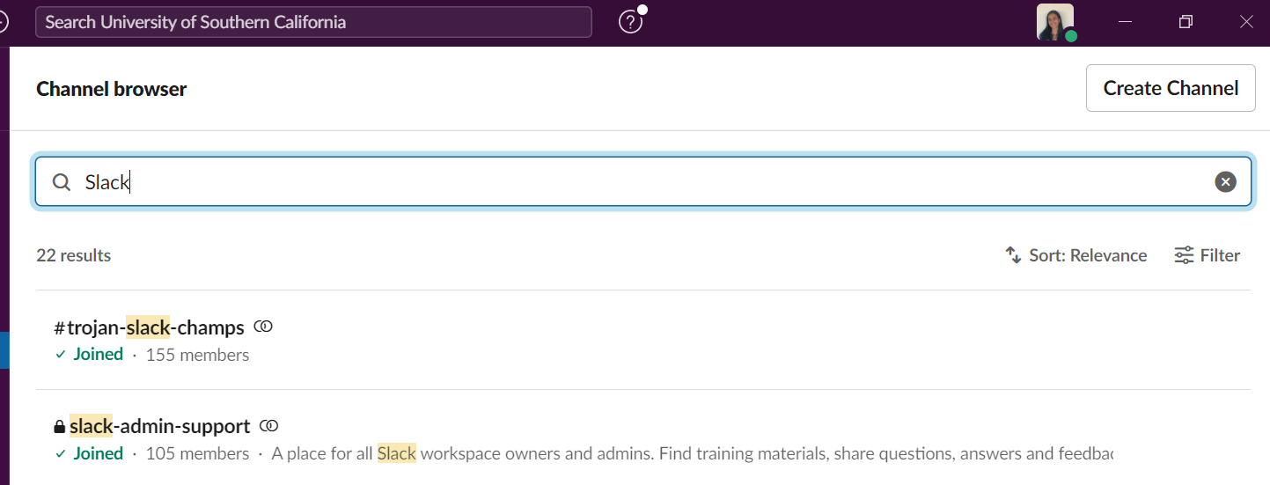
SLACK: Finding SLACK Channel(s)
Slack Admin channel: slack-admin-support
Slack adoption Channel: #trojan-slack-champs

Slide 14
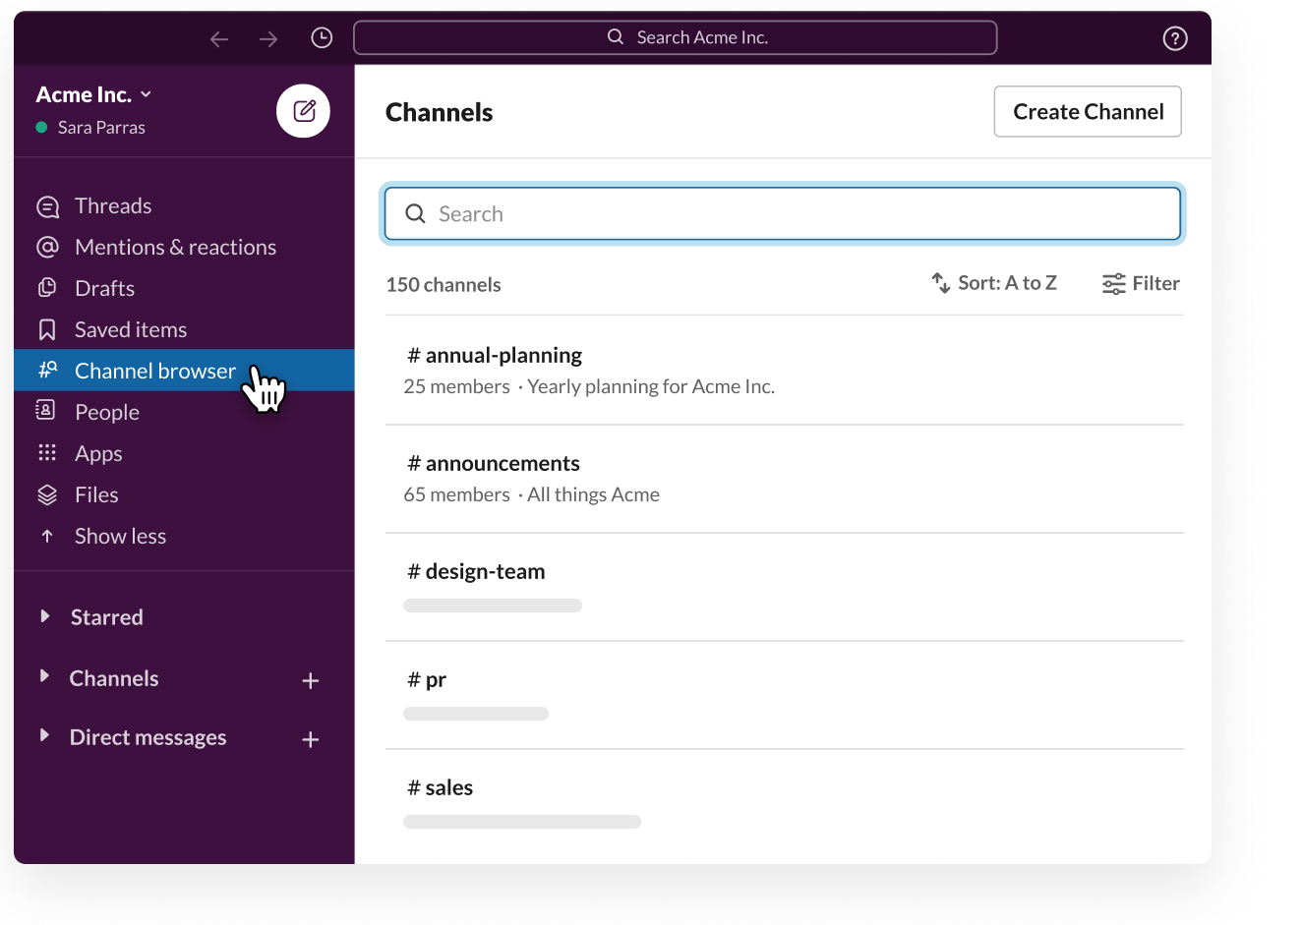
SLACK: Creating a Channel
Create a new channel using clear, predictable naming guidelines.
Public channels should be the default. They provide transparency for you and your team, over time.
If information is sensitive or conversations are limited to small intimate group, private channels can be used.
ITS All
#proj-q4-slack-day
Notes:
Email inbox comparison

Slide 15
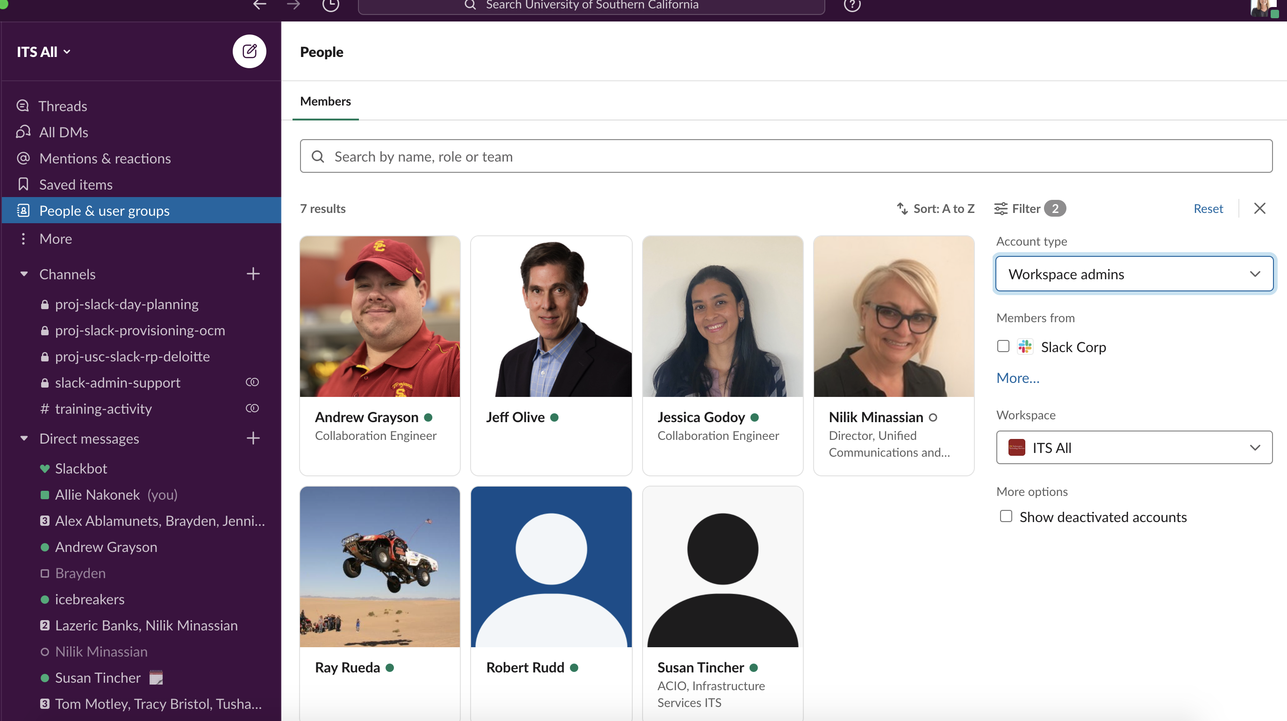
PRO TIP: What to do If Channel creation is limited in your workspace
Reach out to your Workspace Admin if your channel creation is limited in your Workspace.
Find them by going to the People menu, and filtering by Account type = Workspace Admins.

Slide 16
Getting Started: Zoom FOR VIDEO COLLABORATION
ZOOM APP FOR SLACK
Start a Zoom Meeting directly in a Slack channel or group message
See real-time how long the meeting has been running and who is joining
Get and share the duration and participant summary
Dial out via Zoom Phone

Slide 17
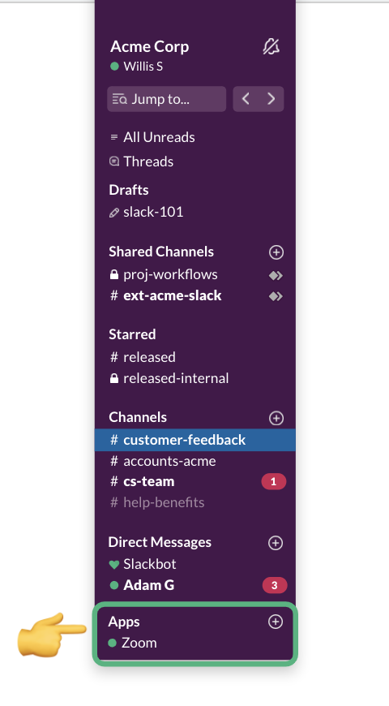
Getting Started: Zoom Authentication FOR USERS
STEP 1
Locate the Zoom app in Slack. Pro tip: use the CMD+K shortcut and type Zoom.
STEP 2
Type /zoom in the message pane and hit enter. This prompt will appear asking you to authorize zoom:

Slide 18
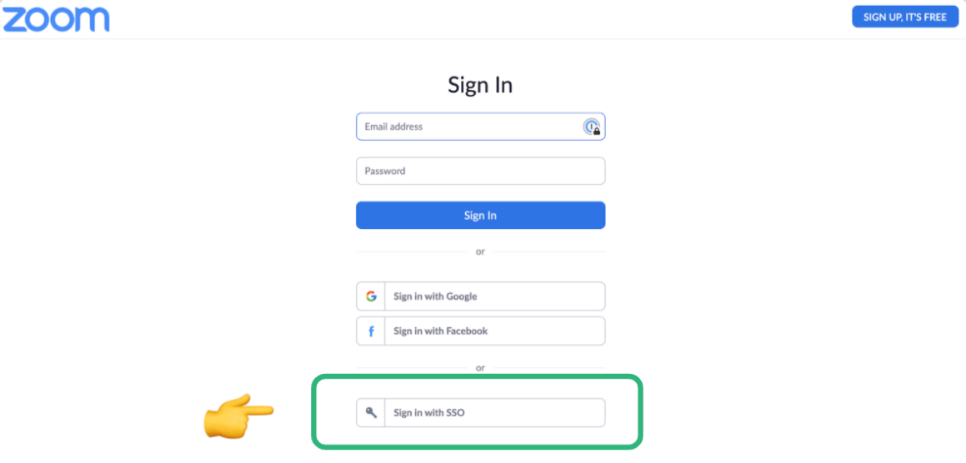
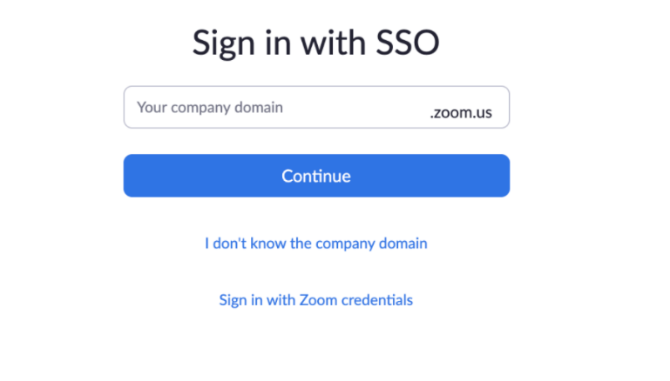
Getting Started: Zoom Authentication FOR USERS
STEP 3
Sign in through SSO with your USC credentials.

Slide 19
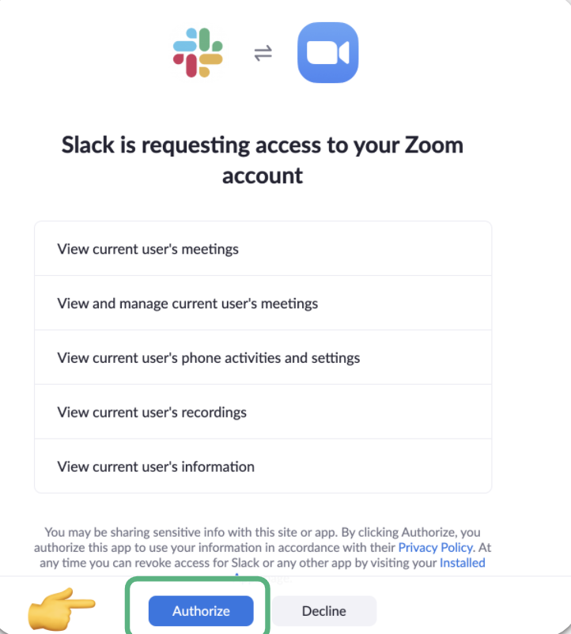
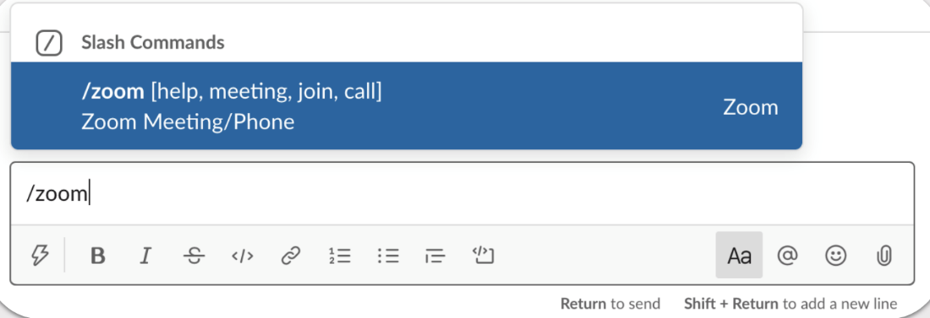
Getting Started: Zoom Authentication FOR USERS
STEP 4
Click to authorize your Zoom account in Slack.
Now you can use /zoom anywhere in Slack to start a zoom call.

Slide 20
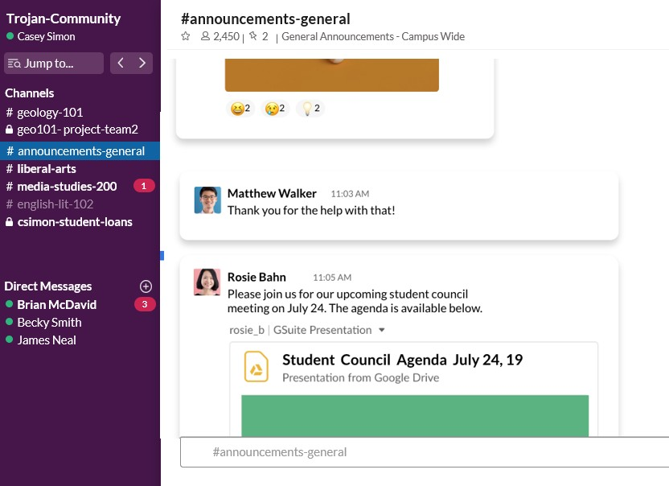
Use case: updates, announcements, Q&A
Updates and Announcements
Pin important class updates and announcements to class channels.
Q&A
Create Q&A channels for students and TAs to crowdsource information.
How is this helpful for students?
Creates a space for students to quickly and easily get information around important class-related topics. This also creates a space for students that aren’t comfortable speaking up in class to ask questions and participate in discussions.
Students can receive updates and announcements related to in class activities or events

Slide 21
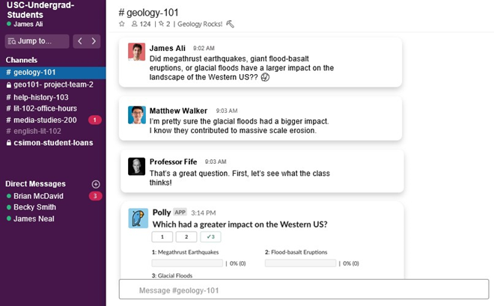
Use Case: Discussions
Communicate
Communicate with staff, faculty and students through public and private channels and direct messages.
Organize
Organize discussions with threads, customize notifications and bookmark important information.
Students can ask their peers a related to class material question and review the ensuing discussion in his class’s #Geology-101 discussion workspace
How is this helpful for students?
Provides students with a forum to discuss material such as homework and lecture notes with peers, professors and T.A.s

Slide 22
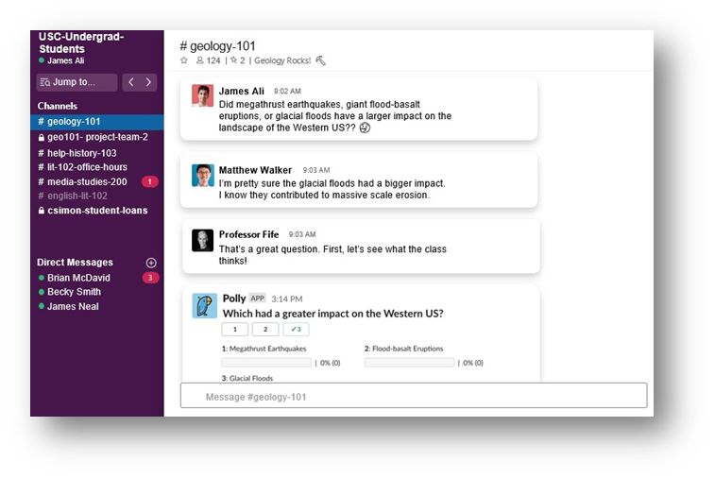
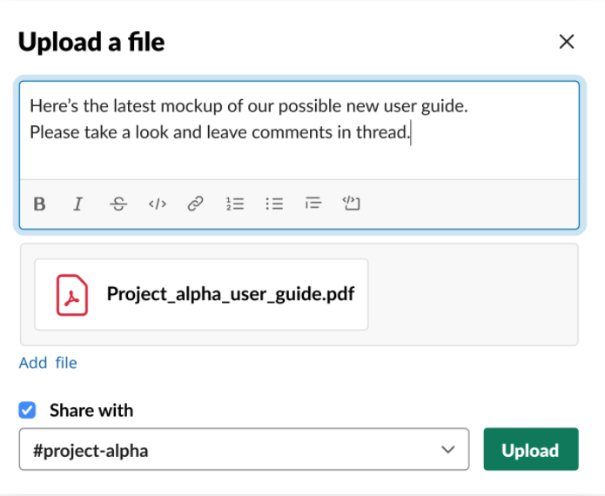
Use case: upload and share files
Upload
Choose and upload documents and files from your device or preferred file management app, such as Google Docs. Uploads are stored, searchable and shareable across your workspace.
Share Documents
Quickly and easily locate uploaded files and share them with your students and colleagues.
How is this helpful for students?
Professors can easily share documents with the entire class with a few clicks. Students can share documents with professors and peers for feedback and peer reviews.

Slide 23
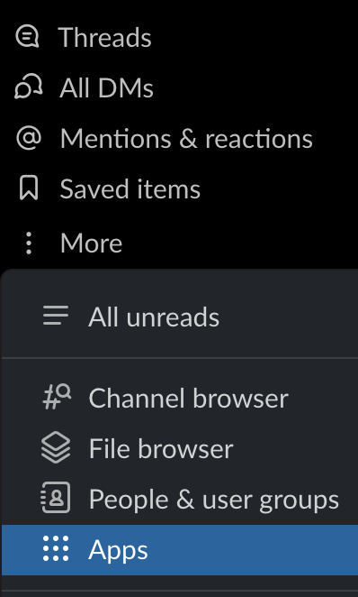
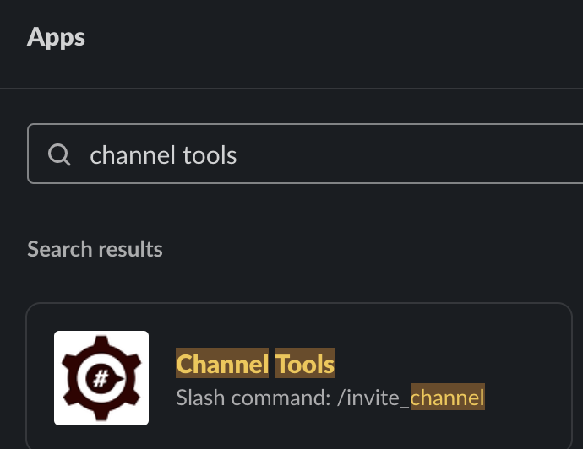
Install Channel Tools
1. In your workspace, click More, select Apps
2. Search for “channel tools”
3. Click Channel Tools and Click Add
4. This will open your web browser to the slack app directory page for Channel Tools

Slide 24
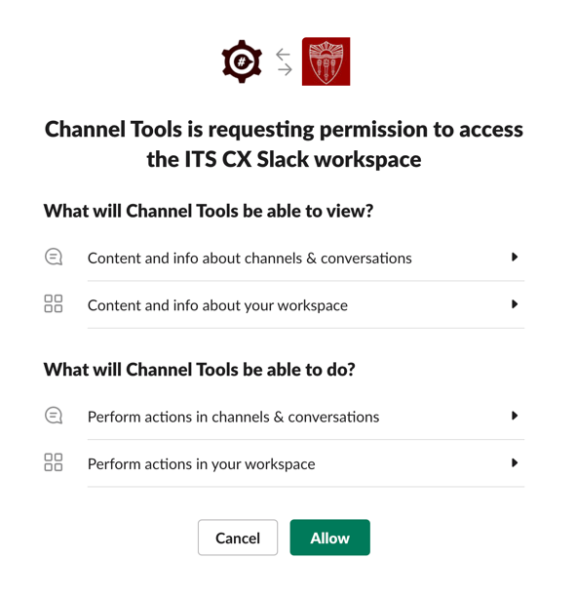
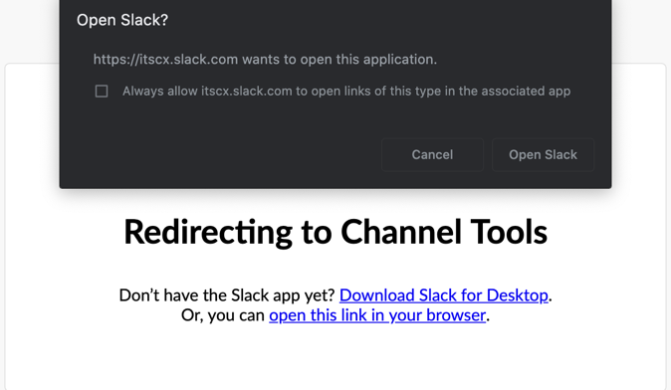
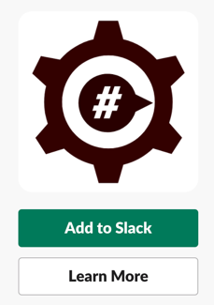
Install Channel Tools
5. Click Add to Slack
6. Click Allow
7. Click Open Slack
8. Add Channel Tools to your source “current” channel
and your destination “new” channel.

Slide 25
Install Channel Tools
Use @channeltools and click Channel Tools
Click Invite Them
In your destination channel, type /channeltools import and hit enter. This will bring up the Channel Tools “Select channel” option.

Slide 26
Install Channel Tools
Choose your source channel and click “Yes, import all members”.
Select More Information if you would like details on the import , or select Done
All members from your source channel should now be in your destination channel.

Slide 27
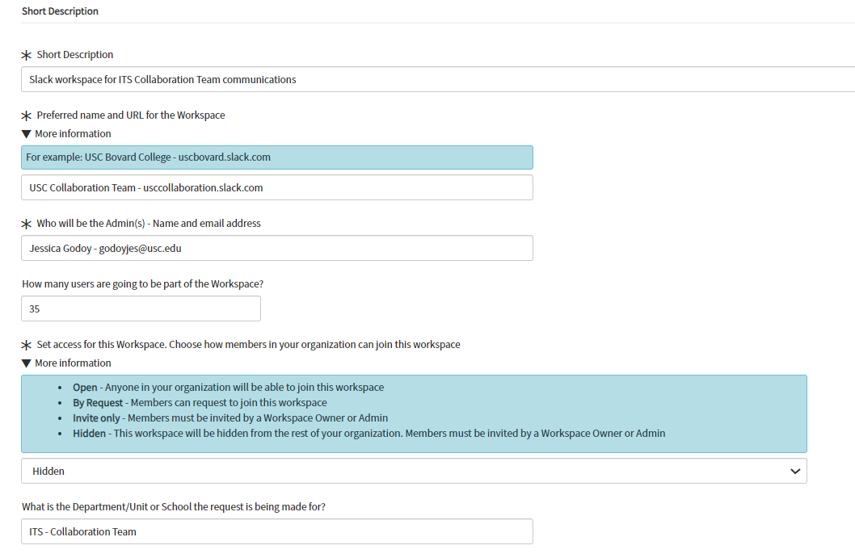
SLACK: SNOW Slack workspace request form

Slide 28
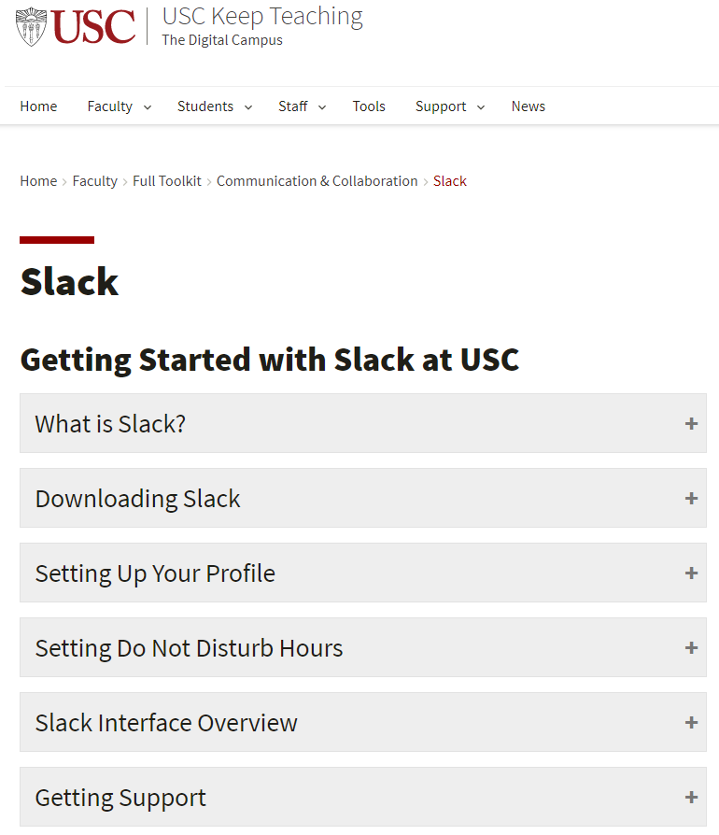
Navigating slack resources
Short overview videos
Step-by-step instructions
Quick reference guides
Keep Teaching Slack Resources
ew Jersey
Notes:
Note to presenter: click on the link in the grey box to access the Keep Teaching Slack Resources page
https://keepteaching.usc.edu/faculty/full-toolkit/communication-collaboration/slack/

Slide 29
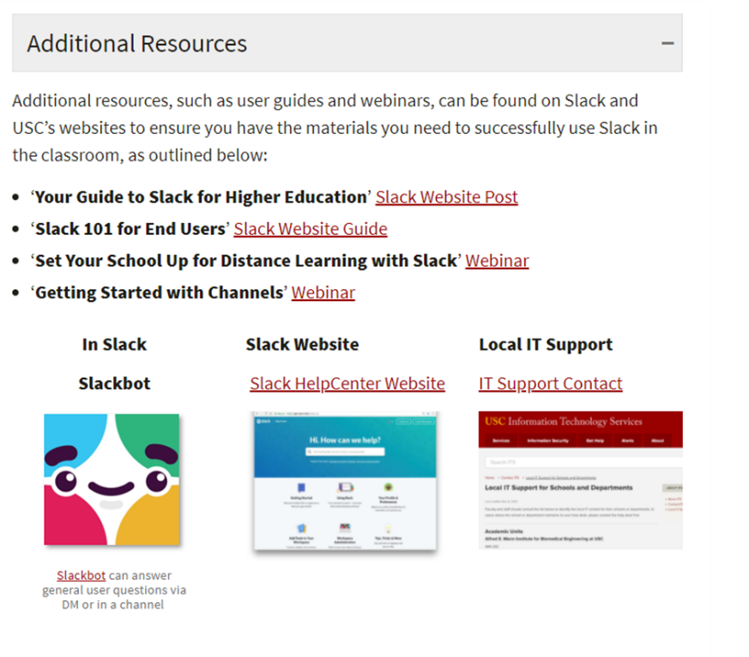
help resources
Additional questions?
Contact ITS – consult@usc.edu - 213-740-5555
Check the News page for the latest information on technological updates, training sessions, best practices and more.
Slack Admin Training: https://trojanlearn.csod.com/ui/lms-learning-details/app/course/7ae3bfc7-fd1d-4c3f-bc86-497798243b9b
Slack Training: https://trojanlearn.csod.com/ui/lms-learning-details/app/course/c69f2f18-827a-48d4-993f-bb677202e4f5
https://keepteaching.usc.edu/support/

Slide 30
Q&A

Slide 31
Thank you & Fight on

